Slide 1
Debugging & Test Driven Development

Slide 2
Outline
What is debugging
Different types of errors and bugs
How to debug with various tools:
Jupyter
Print statements and logging
Debugging console
Using if-else, and try-catch statements to debug
How to prevent bugs:
Test Driven Development

Slide 3
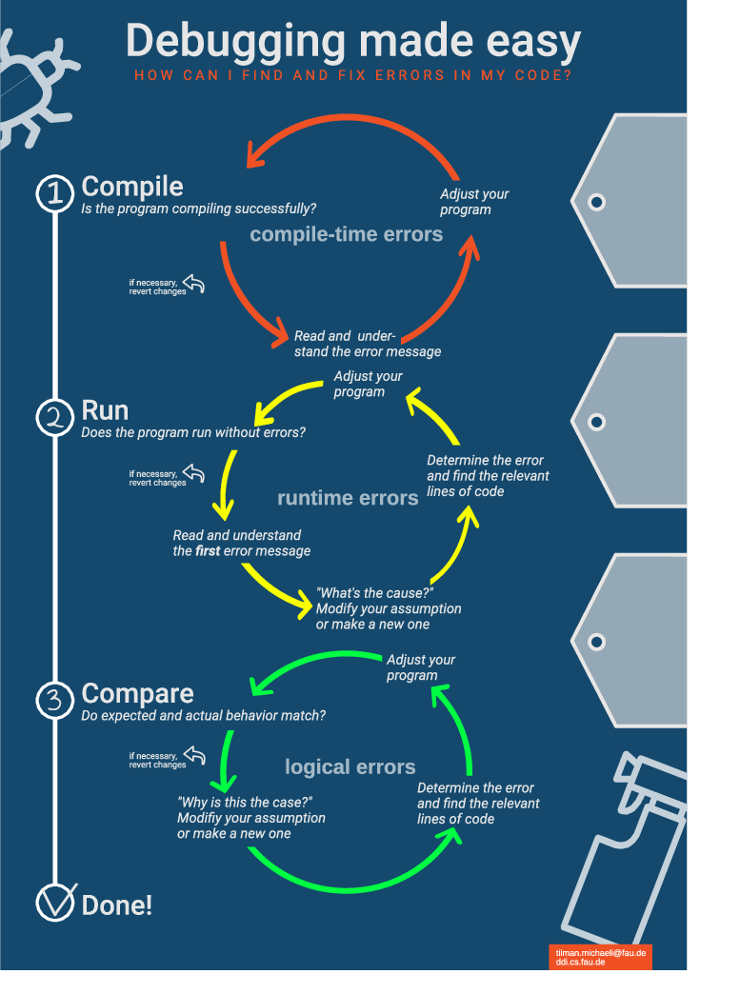
What is debugging
Finding and correcting bugs and defects
Continuous process, issues will pop up at every step in the software’s lifecycle.

Slide 4
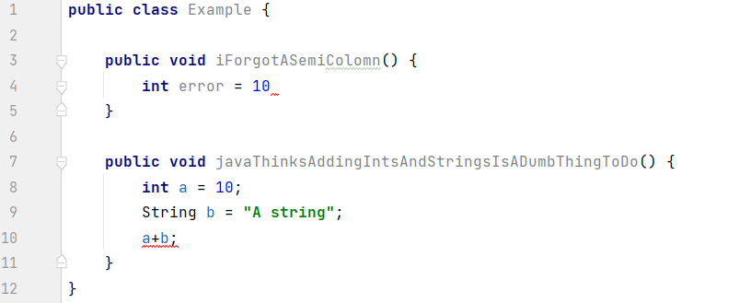
Compile time errors
Bad code that will not compile
Automatically detected by IDE’s
“Strict” languages, like Java, will attempt to catch potential problems early by throwing compile errors
“Relaxed” languages, like python, will throw less compile errors. In return they will have more runtime errors
Easy to find, analyze, and fix

Slide 5
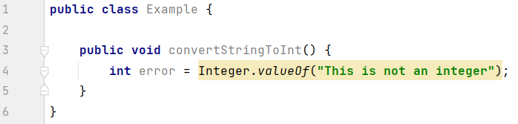
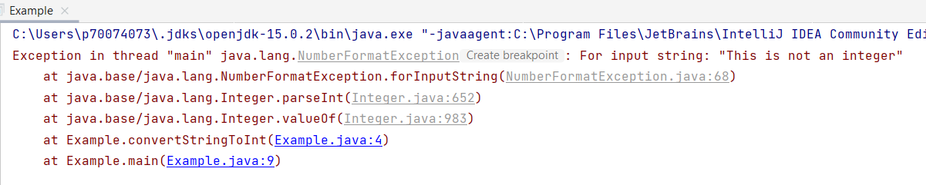

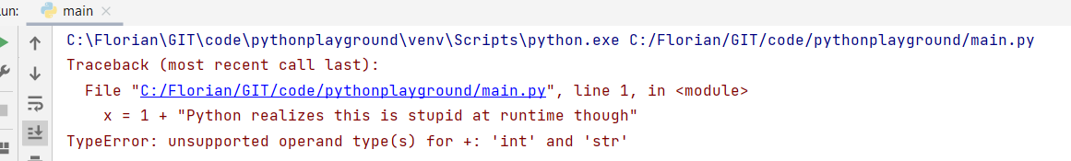
Runtime errors
Code compiles, but an error occurs at runtime
Cannot be automatically detected by the IDE, but a programmer can often see them coming
Relatively easy to find: error shows the line in question
Analyzing can be complex: original cause may be elsewhere in the code
Fixing can be complex: may require rewriting significant parts of the code

Slide 6
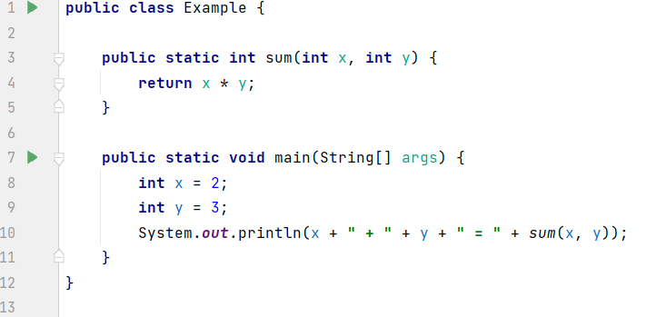

Logical errors
Code runs without errors, but doesn’t do what it’s supposed to do
Will only be detected by running tests
Difficult to find
Analyzing business logic is complex
Fixing business logic is complex
Write good tests and you will have happy users

Slide 7

Debugging with Jupyter notebook:
Step 1: cry
Step 2: get an actual IDE, go debug in there
No debugging tools out of the box
In terms of debugging it’s worse than notepad++
Only useful feature is the pretty printing feature after each cell
Notebook-wide state can lead to weird behavior during debugging
E.g. running the same cell multiple times.

Slide 8
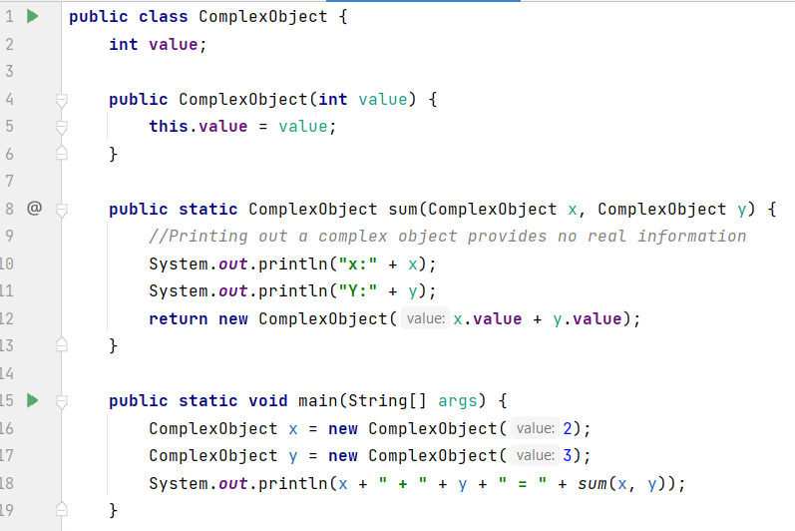
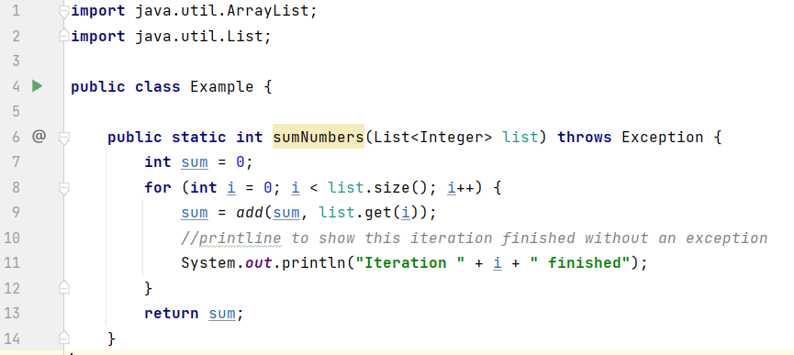
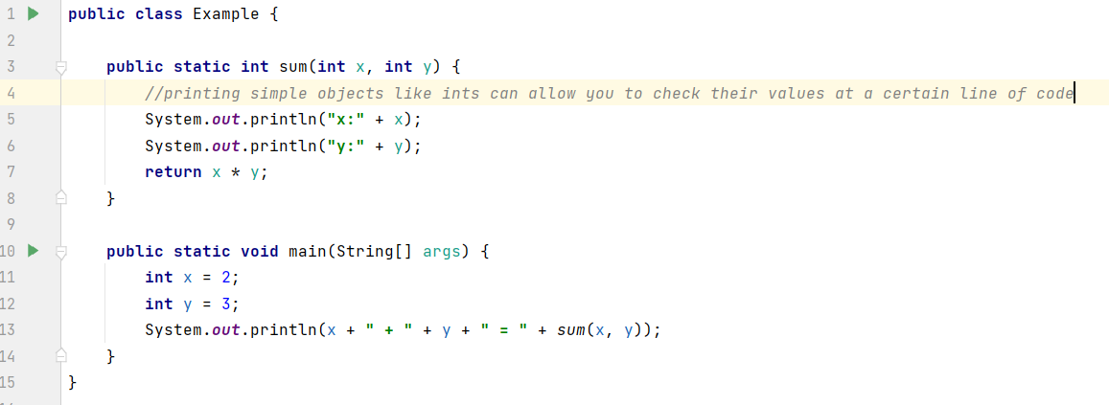
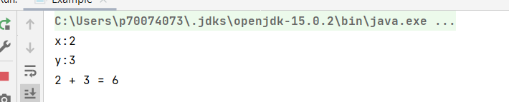
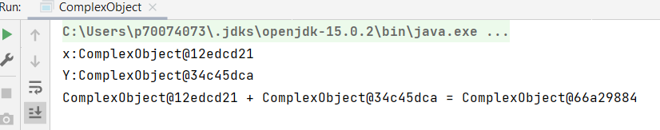
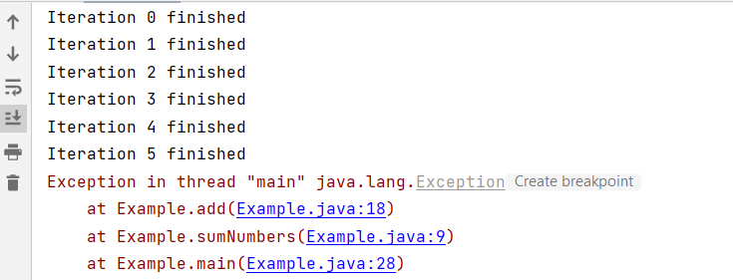
Debugging with print statements (or logging)
Useful to look at the state of a simple variable
Useless for complex objects
Can be used to quickly find an issue, especially useful in loops or recursive code
Quickly becomes overwhelming in large programs

Slide 9
Debugging with print statements (or logging)
Advantages:
Simple & quick
Useful if you already have a good idea of what you’re looking for
Disadvantages:
Not very precise
Can’t handle complex objects
Becomes overwhelming in complex scenarios
If you don’t know what you’re looking for, you won’t know what to print.

Slide 10
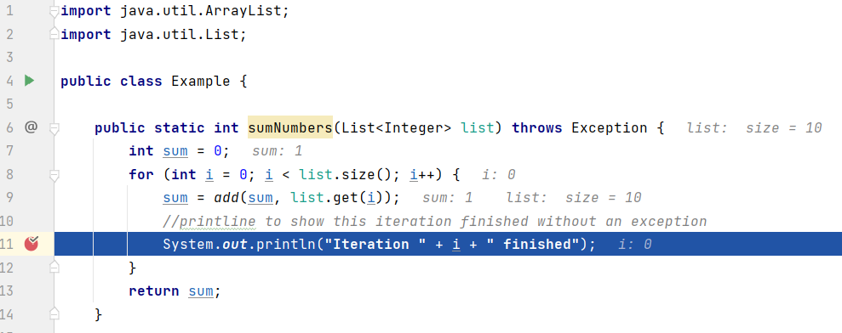
Debugging console
Modern IDE’s allow you to set breakpoints this makes the program “pause”
While paused you have various functionalities

Slide 11
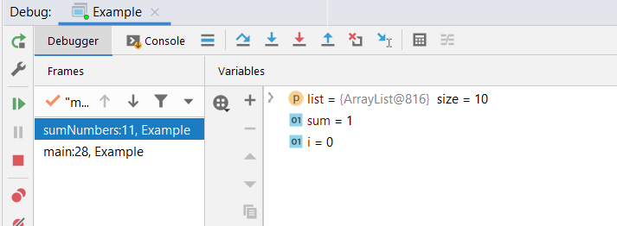
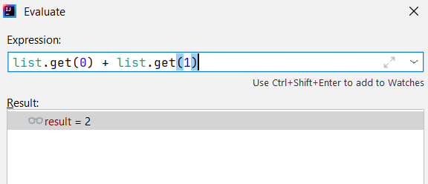
Debugging console functionality
State of elements accessible at this line of code
Ability to evaluate expressions with current state
Ability to navigate program:
Execute next line
Jump to next breakpoint
Revert execution previous line

Slide 12
Debugging console functionality
Advantages:
Complete overview of state of your program
Ability to experiment with expressions to try solutions
Can step through the entire program if needed
Disadvantages:
Scary to use due to perceived complexity and information overload
Finding good breakpoints can be difficult
May force you to look at the horrors contained in a library you use

Slide 13
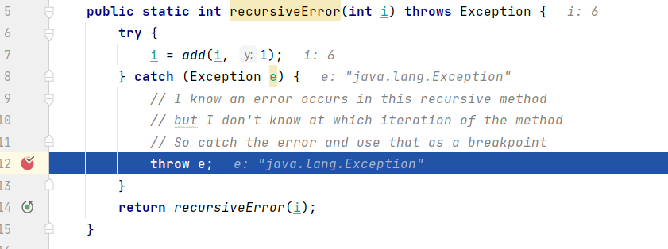
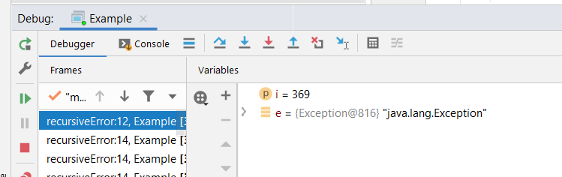
Using if-else, try-catch statements to debug
Difficult to place breakpoints in complex code:
Recursive methods
Complex loops
Lambda’s
Solution: try-catch blocks, or if-else statements to create convenient breakpoints

Slide 14
How to prevent bugs
Write better code:
Adhere to code quality standards
Separate functionalities
Write modular code
Pay attention to what you’re doing
Create clear requirements before you start
Use test-driven development
Good tests will allow you to catch potential problems before they become too complex to handle

Slide 15
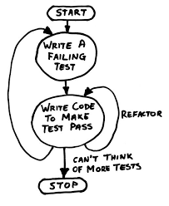
What is Test-Driven Development
Software development approach
Implementing a feature starts with writing tests
Implementing code is solely done to make the tests pass

Slide 16
Why do TTD?
Provides clearly defined goals when implementing
Identifies issues, both functional and programmatically, early on
Identifies issues in different parts of the code, even those you think you aren’t touching
Provides a metric for code quality
Provides a quick development cycle
Encourages modular design as well as a coherent architecture
Minimizes changes when new features are introduced

Slide 17
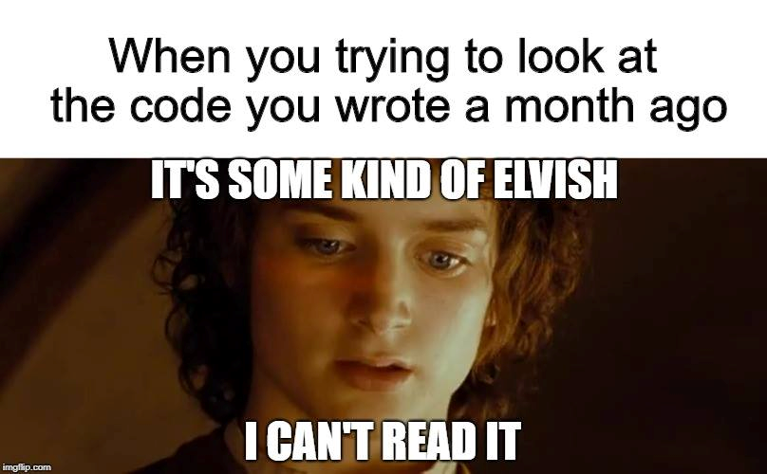
Biggest advantage: Tests make code (and bugs) understandable

Slide 18
Step one: decide on a new feature
Add the income from two people together

Slide 19
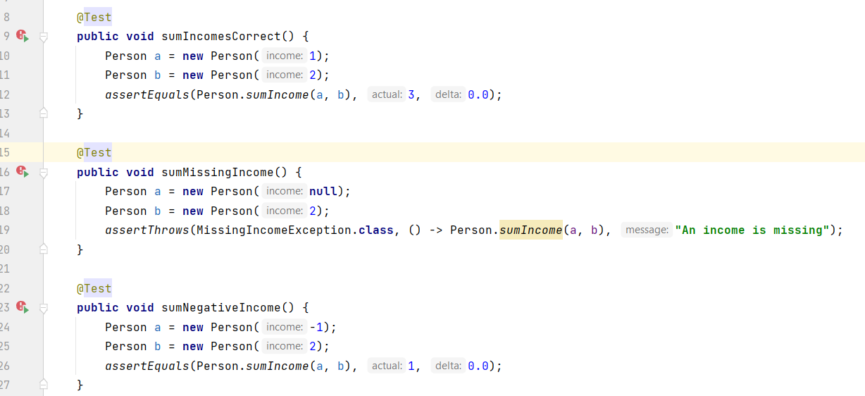
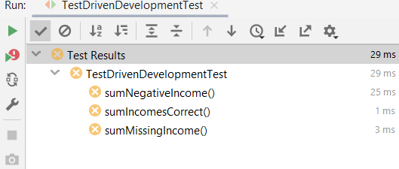
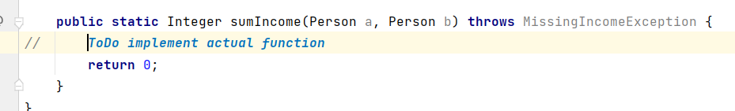
Step 2: create tests and watch them fail
Step one: decide on a new feature;
Our feature: add the income from two people together
Step two: create tests

Slide 20
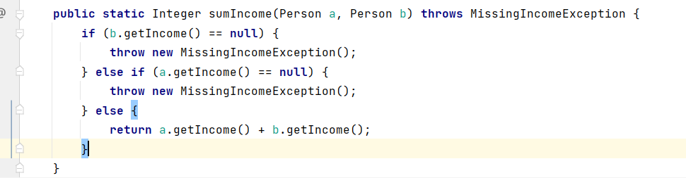
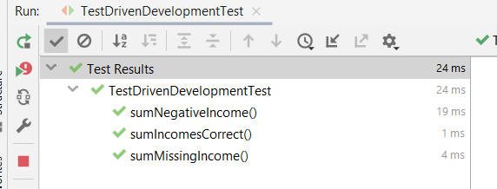
Step 3: write code that passes the tests
Step one: decide on a new feature;
Our feature: add the income from two people together
Step two: create tests

Slide 21
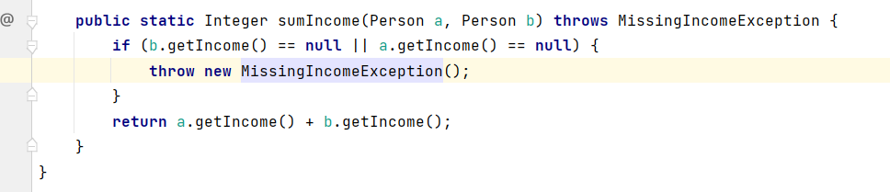
Step 4: Clean up code, and move on to the next feature
Step one: decide on a new feature;
Our feature: add the income from two people together
Step two: create tests

Slide 22

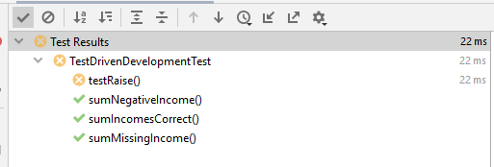
Step 1: Start a new feature and add new tests to cover this feature
Step one: decide on a new feature;
Our feature: add the income from two people together
Step two: create tests

Slide 23
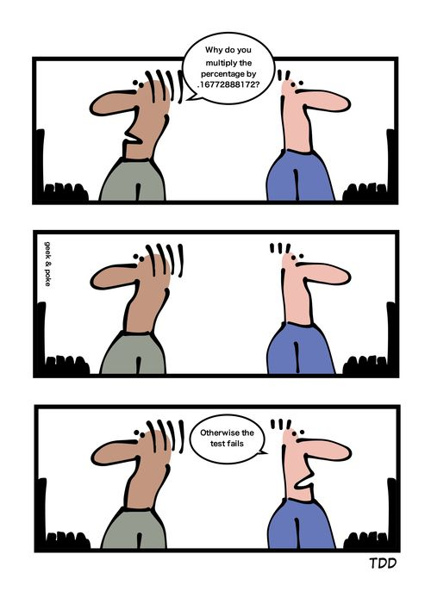
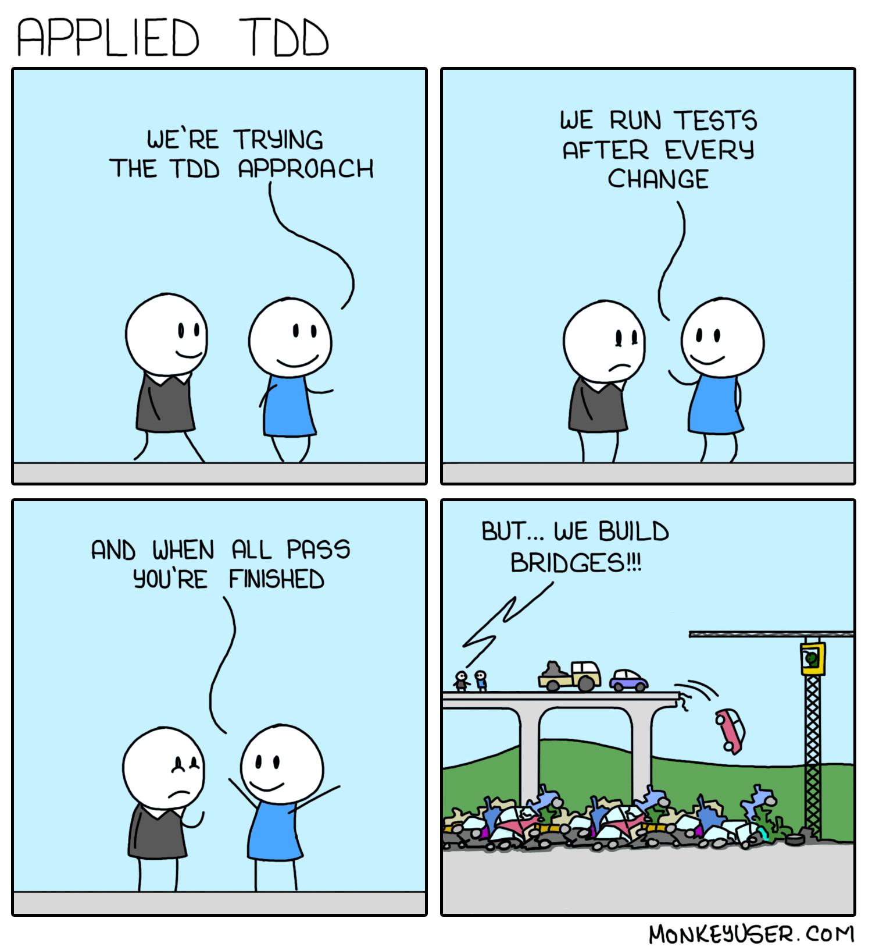
TDD: Theory v.s. Practice
Theoretically all tests should be defined before any code is written
In practice this isn’t possible
Usefulness highly dependents on quality of the tests & programmers
Designing good tests, and covering all important scenarios, requires practice
Writing tests can feel like pointless busywork, especially for inexperienced programmers
You will be glad you’ve done it when a test catches a mistake before you your 3-week experiment crashes in week 2
You don’t need a 100% test-coverage

Slide 24
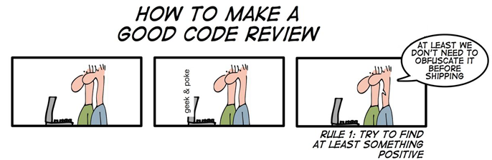
TDD: How to get good at it?
Practice
Review code & tests written by others
Have others review your code & tests

